Slide 1


Green Pace
Security Policy Presentation
Developer: Hannah Hendrix
Policies, Standards, Principles, and Best Practices

Slide 2

OVERVIEW: DEFENSE IN DEPTH
What is Defense in Depth?
A multi-layered approach to security with overlapping defenses to ensure no single vulnerability leads to system compromise.
Why is it Needed?
Rapid team growth risks misalignment of best practices.
Increasing coding vulnerabilities and architectural risks.
Threats from internal and external sources.
How Does it Support Best Practices?
Reduces attack surface area.
Applies standardized polices and testing practices.
Aligns automation, encryption, and testing for continuous activity.
Source: Fortinet (2024)

Slide 3
THREATS MATRIX
Likely: Input validation failures, hardcoded credentials, and unpatched libraries are frequent vulnerabilities that can lead to severe exploits if not addressed.
Priority: Weak encryption, insufficient authentication, and improper access controls pose significant risks with high potential damage, even if not as frequent.
Low Priority: Misleading error messages and incomplete logging are minor vulnerabilities but should still be monitored to avoid indirect exploits.
Unlikely: Buffer overflow vulnerabilities or system misconfigurations are rare but could be exploited in specific scenarios. These require periodic checks.
Likely: Input Validation Errors: Missing or weak input validation, leading to injection attacks (e.g., SQL injection, XSS). Hardcoded Credentials: Credentials embedded in source code are easy targets for attackers. Unpatched Libraries: Using outdated third-party libraries with known vulnerabilities. | Priority: Weak Encryption: Data is not encrypted in transit or at rest, leaving sensitive information exposed. Insufficient Authentication: Weak or missing authentication controls (e.g., no multi-factor authentication). Improper Access Control: Users have unauthorized access to resources or data.
Low Priority: Misleading Error Messages: Error messages that reveal internal system details, which could aid attackers. Logging Issues: Lack of proper logging for failed access attempts or system anomalies. | Unlikely: Buffer Overflow: Rare vulnerabilities caused by improper memory handling in specific modules. Rare System Misconfigurations: Configuration errors that occur only in edge cases or complex environments.

Slide 4
10 PRINCIPLES
Validate Input Data Coding Standard: Verify all input data for size, type, format, and acceptable value ranges before processing.
Heed Compiler Warnings Coding Standard: Resolve all compiler warnings to prevent potential security flaws and functional errors.
Architect and Design for Security Policies Coding Standard: Incorporate security into software architecture and design from the beginning.
Keep It Simple Coding Standard: Design systems to be simple, testable, and maintainable to minimize errors.
Default Deny Coding Standard: Deny all access by default and explicitly grant only necessary permissions.
Adhere to the Principle of Least Privilege Coding Standard: Grant only the minimum permissions necessary for users, processes, and applications.
Sanitize Data Sent to Other Systems Coding Standard: Validate and sanitize all data sent to external systems to prevent injection attacks.
Practice Defense in Depth Coding Standard: Implement multiple layers of security controls, including firewalls, encryption, and application-level security.
Use Effective Quality Assurance Techniques Coding Standard: Conduct peer reviews, penetration testing, and static code analysis to identify and resolve vulnerabilities.
Adopt a Secure Coding Standard Coding Standard: Follow secure coding standards like CERT C/C++ or MISRA C to promote consistency and reduce vulnerabilities.

Slide 5
CODING STANDARDS
Standard | Severity | Likelihood | Remediation Cost | Priority
[STD-001-DAT] Data Type Usage: Ensures proper data types are used to prevent precision loss, overflows, and unexpected behavior. | High | Likely | Low | 5
[STD-002-VAL] Data Value Validation: Validates input values to avoid out-of-range errors and undefined behavior. | High | Likely | Medium | 5
[STD-003-STR] String Correctness: Prevents buffer overflows and unsafe string operations by enforcing secure string handling. | High | Very Likely | Medium | 5
[STD-004-SQL] SQL Injection Prevention: Ensures all inputs used in SQL queries are sanitized through parameterized queries. | High | Very Likely | Low | 5
[STD-005-MEM] Memory Protection: Ensures proper allocation and deallocation of memory to avoid leaks and undefined behavior. | High | Likely | Medium | 5
[STD-006-ASS] Assertions: Enforces critical assumptions at runtime to prevent unexpected behavior. | Medium | Possible | Low | 4
[STD-007-EXP] Exception Handling: Ensures proper error handling to prevent crashes and improve program stability. | High | Likely | Medium | 5
[STD-008-LOG] Logging and Auditing: Logs critical operations for accountability and troubleshooting while avoiding exposure of sensitive data. | Medium | Likely | Low | 3
[STD-009-LCK] Thread Safety and Locking: Ensures proper synchronization in multi-threaded environments to avoid race conditions and deadlocks. | High | Very Likely | High | 5
[STD-010-ENC] Encryption Standards: Requires robust encryption for data at rest, in flight, and in use to maintain confidentiality and integrity. | High | Likely | High | 5

Slide 6
ENCRYPTION POLICIES
Encryption in Flight
Policy: All data transmitted between systems must use secure protocols (e.g., TLS 1.2+).
Why: Protects data from interception during transmission.
Examples:
HTTPS for web traffic
Secure API communications with TLS
Encryption at Rest
Policy: Sensitive data must be encrypted using AES-256 or equivalent.
Why: Protects stored data from unauthorized access.
Examples:
Database encryption
Encrypted backups
Encryption in Use
Policy: Encrypt sensitive data in memory during processing.
Why: Prevents unauthorized access during runtime.
Examples:
Secure enclaves or Trusted Environments (TEES).
Masking sensitive data during processing.
Source: (Dinic, 2022)

Slide 7
TRIPLE-A POLICIES
Authentication
Policy: All users and systems must authenticate using strong mechanisms, including Multi-Factor Authentication (MFA).
Why: Ensures only authorized users access Green Pace resources.
Examples:
MFA for all accounts
Secure password polices (e.g., minimum length, complexity.
Use OAuth 2.0 or OpenID Connect for API authentication
Authorization
Policy: Enforce the Principle of Least Privilege (PoLP), allowing access only to resources necessary for roles.
Why: Minimizes risks from unauthorized actions or data breaches.
Examples:
Role-based access control (RBAC).
Regular audits of permissions.
Access control lists (ACLs) for files and systems.
Accounting
Policy: Log and monitor all access and changes to resources to ensure accountability and compliance.
Why: Provides an audit trail for investigations and compliance reporting.
Examples:
Log user login attempts and administrative actions.
Monitor file access and modifications.
Use centralized logging tools (e.g., Splunk or ELK Stack).
Source: (Fortinet, 2023)

Slide 8
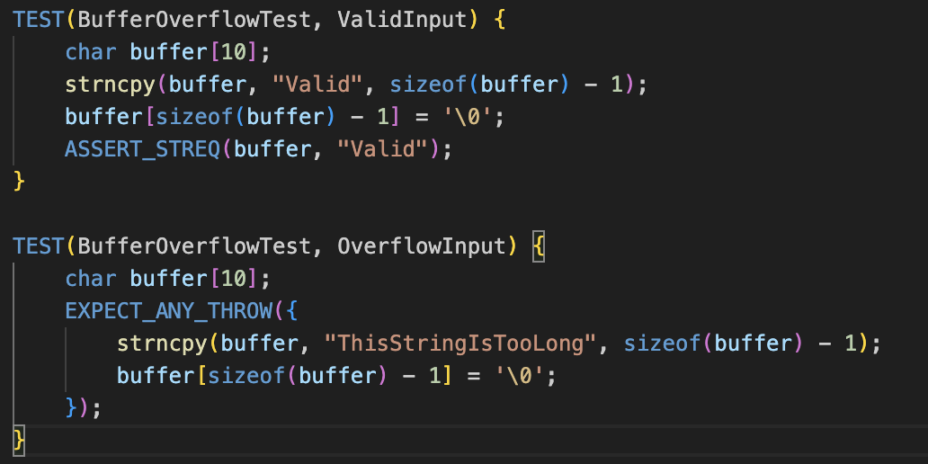
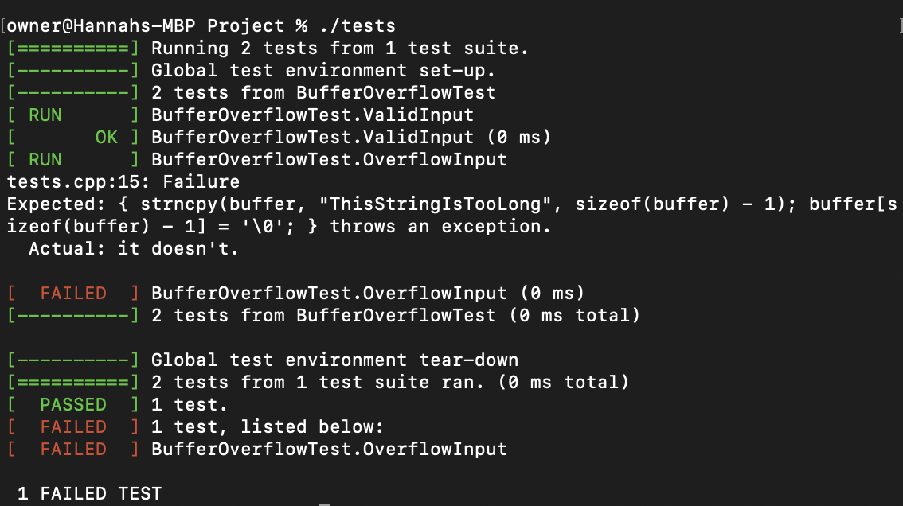
Unit Testing
Vulnerability Tested: Input Validation for Buffer Overflows
Test Details:
Positive Test: Input string of acceptable length passes without errors.
Negative Test: Input string exceeding buffer size triggers an exception or prevents overflow
Code Snippet:
Results:

Slide 9
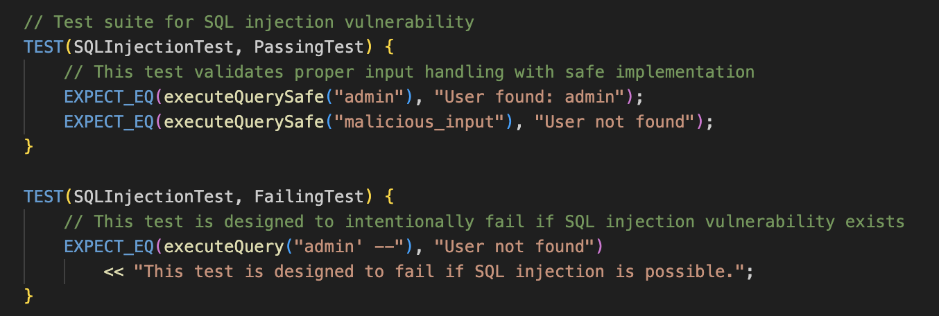
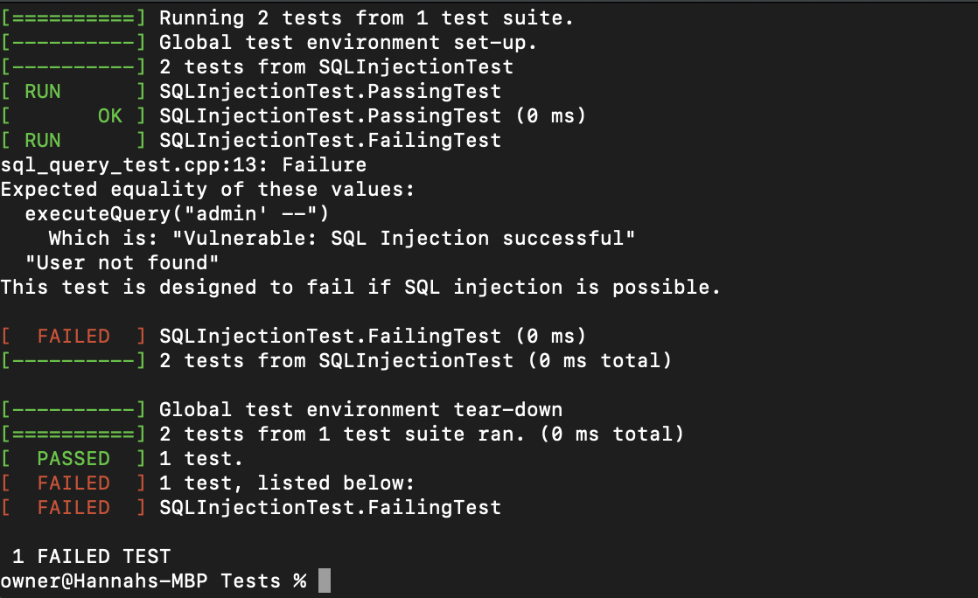
Unit Testing
Vulnerability Tested: SQL Injection
Test Details:
Positive Test: The executeQuerySafe function handles inputs securely and returns correct results.
Negative Test: The executeQuery function demonstrates the SQL injection vulnerability.
Code Snippet:
Results:

Slide 10
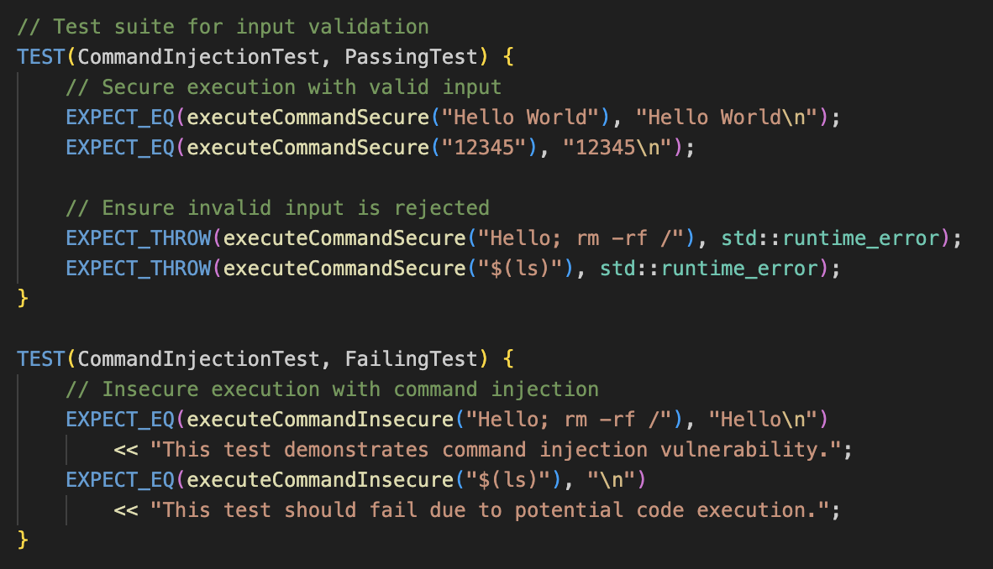
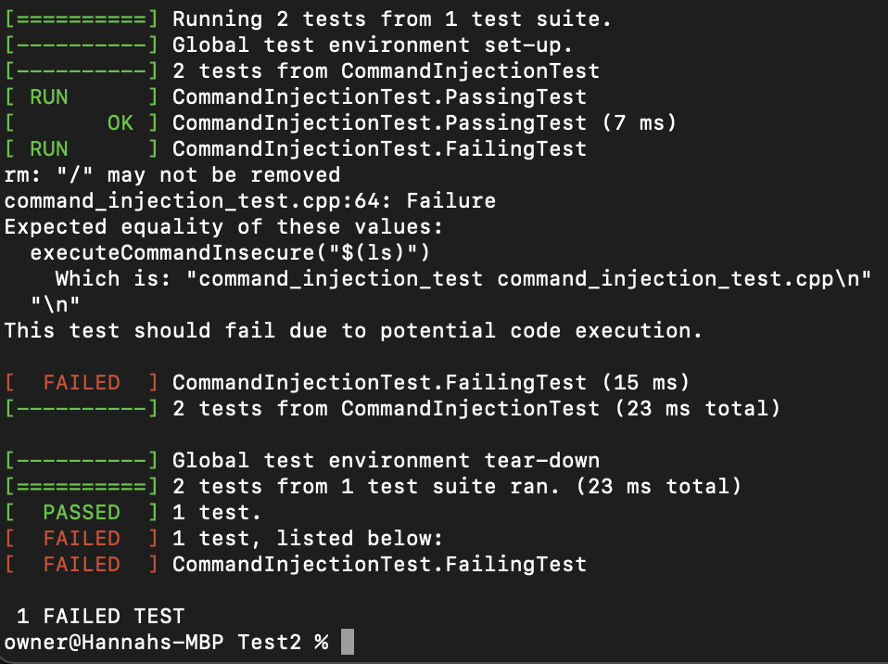
Unit Testing
Vulnerability Tested: Command Injection
Test Details:
Positive Test:
The executeCommandSecure function handles inputs securely by validating user input to allow only alphanumeric characters and spaces.
Valid inputs like "Hello World" return correct results, and invalid inputs like "Hello; rm -rf /" are safely rejected with exceptions.
Negative Test:
The executeCommandInsecure function demonstrates the command injection vulnerability.
Malicious inputs like "Hello; rm -rf /" bypass validation and are executed, exposing the system to security risks.

Slide 11
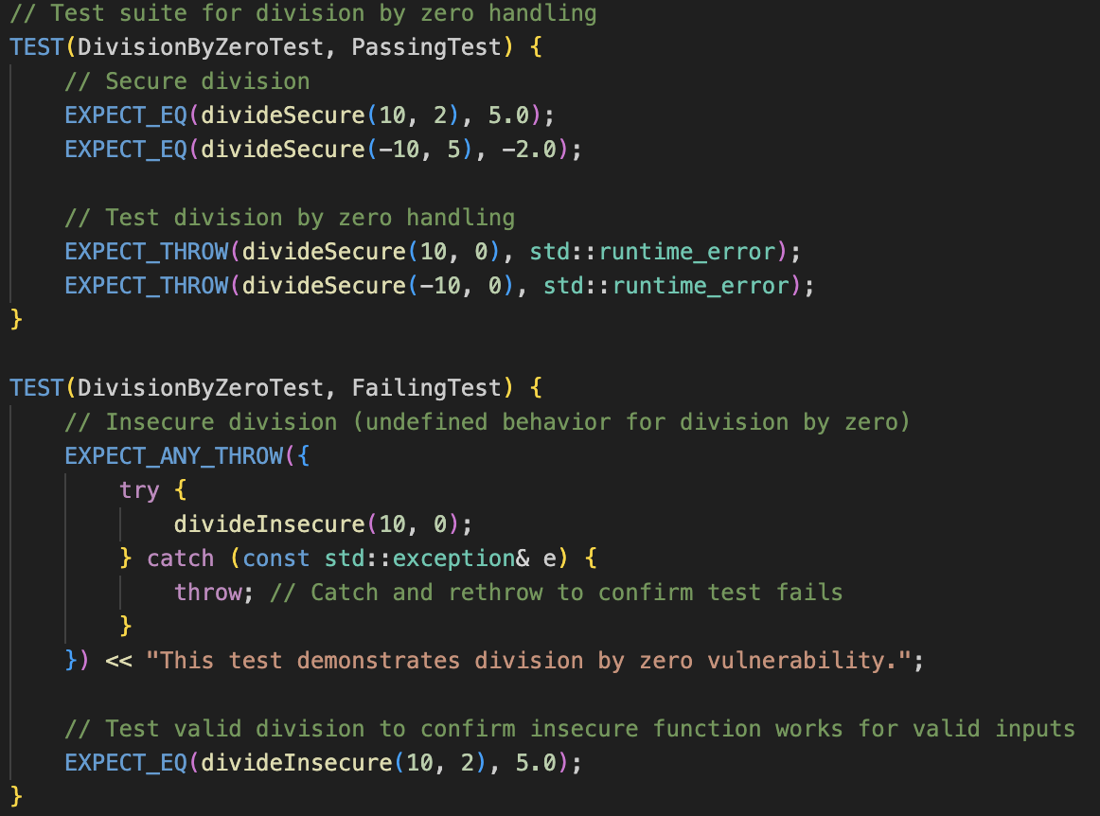
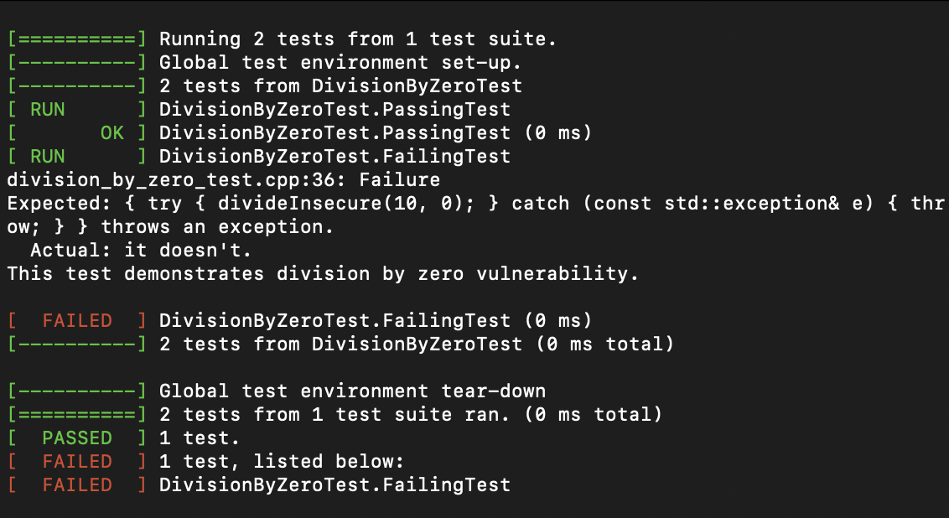
Unit Testing
Vulnerability Tested: Division By Zero
Test Details:
Positive test: The divideSecure function handles inputs securely by validating the denominator before performing division.
For valid inputs like 10 / 2, it correctly returns 5.0.
For invalid inputs, such as dividing by zero, it throws a std::runtime_error to prevent undefined behavior.
Negative Test:
The divideInsecure function demonstrates the division by zero vulnerability.
It does not validate the denominator, allowing undefined behavior or potential crashes when dividing by zero.
This test intentionally fails to emphasize the risks of not handling division by zero.

Slide 12

AUTOMATION SUMMARY

Slide 13
TOOLS
DevSecOps Pipeline:
Pre-Production:
Assess and Plan: Threat modeling tools (e.g., OWASP Threat Dragon) identify potential vulnerabilities and regulatory impacts.
Design: Security-driven design frameworks and static analysis tools (e.g., SonarQube) ensure best practices are followed.
Build: Trusted repositories and secure open-source tools (e.g., Snyk) validate code dependencies and prevent vulnerabilities.
Verify and Test: Vulnerability scanners (e.g., Cppcheck) and compliance testing tools validate functional and security standards.
Production:
Transition and Health Check: Penetration testing tools (e.g., OWASP ZAP) validate deployment security configurations.
Monitor and Detect: SIEM tools (e.g., Splunk) and intrusion detection systems (e.g., Snort) monitor and log system activity.
Respond: Incident response platforms (e.g., Splunk Phantom) block attacks, rollback changes, and initiate remediation.
Maintain and Stabilize: Post-incident assessments ensure systems return to baseline security and stable functionality.
Source: (GitHub, 2024)

Slide 14
RISKS AND BENEFITS
Problems:
Late integration of security increases undetected vulnerabilities.
Over-reliance on reactive measures raises remediation costs.
Limited automation leads to inconsistencies and human error.
Solutions:
Integrate security early with tools like OWASP Threat Dragon.
Automate testing using tools such as Cppcheck and OWASP ZAP.
Implement real-time monitoring with SIEM and intrusion detection.
Risks and Benefits:
Act Now: Reduces vulnerabilities early and improves system integrity but requires upfront investment.
Wait: Saves costs temporarily but increases risks of breaches and reputational damage.
Steps to Take:
Prioritize early security integration.
Automate testing in CI/CD pipelines.
Develop an incident response plan for post-incident recovery.

Slide 15
RECOMMENDATIONS
Gaps in the Security Policy:
Runtime Security: Limited focus on real-time threat detection and response during production.
Incident Response Plan: No comprehensive plan for addressing security incidents or recovering post-breach.
Automation Gaps: Inconsistent application of security automation in the CI/CD pipeline.
Third-Party Dependencies: Insufficient monitoring of vulnerabilities in third-party libraries and open-source tools.
Recommendations:
Implement real-time monitoring tools like SIEM and Runtime Application Self-Protection (RASP).
Develop and test a robust incident response plan to ensure rapid recovery.
Fully automate security testing during the build and verification phases.
Use tools like Snyk to monitor and manage vulnerabilities in third-party dependencies.

Slide 16
CONCLUSIONS
Standards to Adopt:
Secure Coding Standards:
Follow standards like CERT C/C++ and MISRA C to enforce secure coding practices and reduce vulnerabilities.
OWASP Application Security Verification Standard (ASVS):
Use OWASP ASVS to ensure robust application-level security by following best practices.
NIST Cybersecurity Framework:
Implement NIST standards for a comprehensive approach to identify, protect, detect, respond, and recover from threats.
Continuous Security Testing:
Adopt tools like SAST (Static Application Security Testing) and DAST (Dynamic Application Security Testing) for ongoing security validation.
Key Takeaways:
Adopting these standards will minimize vulnerabilities, ensure compliance, and create a stronger security foundation for future projects.
Continuous improvement and automation are key to adapting to evolving security challenges.

Slide 17
REFERENCES
Dinic, M. (2022, May 2). Encryption: Data at Rest, Data in Motion and Data in Use. Jatheon. https://jatheon.com/blog/data-at-rest-data-in-motion-data-in-use/
Fortinet. (2023). What Is AAA Security? Fortinet. https://www.fortinet.com/resources/cyberglossary/aaa-security
Fortinet. (2024). What is Defense in Depth? Defined and Explained. Fortinet. https://www.fortinet.com/resources/cyberglossary/defense-in-depth
GitHub. (2024). What is a DevOps pipeline? A complete guide. GitHub. https://github.com/resources/articles/devops/pipeline

